Slide 1
Wrapper Classes

Slide 2
Need of Wrapper Classes
They convert primitive data types into objects. Objects are needed if we wish to modify the arguments passed into a method (because primitive types are passed by value).
The classes in java.util package handles only objects and hence wrapper classes help in this case also.
Data structures in the Collection framework, such as ArrayList and Vector, store only objects (reference types) and not primitive types.
An object is needed to support synchronization in multithreading.

Slide 3
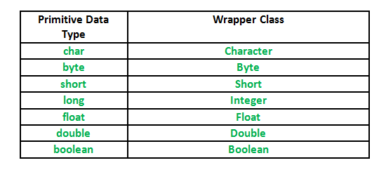
Primitive Data types and their Corresponding Wrapper class

